Slide 1
CS 419: Production Rendering Depth of Field
Eric Shaffer

Slide 2
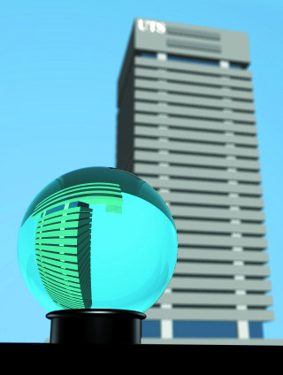
Depth of Field
Depth of Field is a parameter of the camera
It is the range of distances over which objects appear in focus
What is the depth of field of our pinhole camera model?
Real cameras have a finite-aperture lens
Focus perfectly at a single distance called the focal distance
Notes:
It’s infinite…the lens is a point and so infinitely small

Slide 3
Thin Lens Theory
Thin lens: when the thickness of the lens is negligible compared to the radius
Focal planes and image planes exist in matched pairs

Slide 4
Thin Lens Theory
Points off the focal plane generate a circle of confusion on the image plane
The further point q gets from the focal plane, the more out of focus it gets (larger circle)

Slide 5
Thin Lens Theory
This idealized camera has 0 depth of field
Traditional film has finite grain sizes which allow a range of distances to be in focus
Similarly digital cameras will be in focus whenever the circle of confusion is smaller than a pixel

Slide 6
Simulating a Thin Lens
We’ll do the traditional CG thing and approximate and hack
We’ll use a disc centered on the eye point, parallel to the view plane
it has 0 thickness
We won’t calculate exactly how the light is refracted ….

Slide 7
Multiple rays are shot per-pixel
Select focal distance
For each pixel:
Center ray finds p
Primary rays
Origin random on lens
Go through P
Average samples to get final color for pixel
Notes:
Center ray finds p
All randomly sourced rays from lens for the current pixel go through p
Those are the primary rays used to generate the color for the pixel
Average the samples to get the final color

Slide 8
Some questions
How do we generate the samples on the lens?
What happens as we make the lens radius bigger?
For a pixel in the final image to be perfectly in focus, what must be true about the samples that generated it?

Slide 9
We can add anti-aliasing
Since all primary rays for a pixel go though p, we aren’t really anti-aliasing
For hit points away from the focal plane, the blur from depth of field obliterates aliasing
For a scene near the focal plane, we need antialiasing

Slide 10
Depth of Field and Anti-aliasing
Use a different center ray for each primary…use jittering or multi-jittering
The focal plane intersections will be at slightly different locations

Slide 11
Anti-aliasing and Depth of Field

Slide 12
Fast Intersection of Center Rays
Can use similar triangles to find p
f is the focal length
d is the viewplane distance
Note: we need to convert from viewing coordinates to world
Direction will need to be normalized

Slide 13
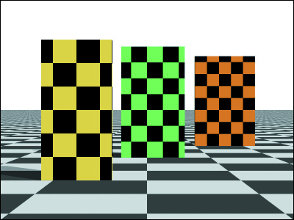
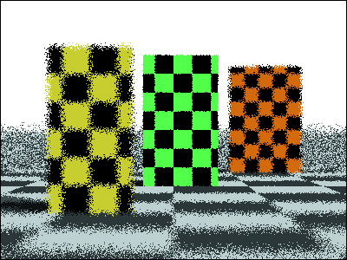
Results
zero radius lens
lens radius 1 1 sample per pixel

Slide 14
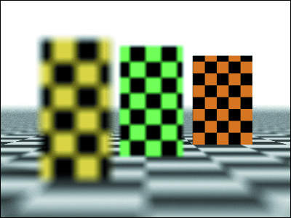
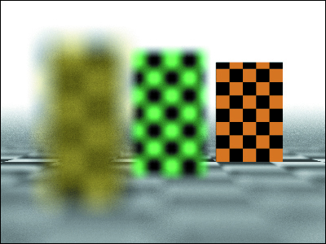
Results
Increasing lens radius requires more samples per pixel for quality image

